Slide 1
COSC3503 Section 1 Operating Systems Chapter 7 Deadlocks
Doug Lim

Slide 2
Objectives
To develop a description of deadlocks, which prevent sets of concurrent processes from completing their tasks
To present a number of different methods for preventing or avoiding deadlocks in a computer system

Slide 3
System Model
System consists of resources
Resource types R₁, R₂, . . ., R_{m}
CPU cycles, memory space, I/O devices
Each resource type R_{i} has W_{i} instances.
Each process utilizes a resource as follows:
request
use
release

Slide 4
Deadlock Characterization
Deadlock can arise if four conditions hold simultaneously.
Mutual exclusion: only one process at a time can use a resource
Hold and wait: a process holding at least one resource is waiting to acquire additional resources held by other processes
No preemption: a resource can be released only voluntarily by the process holding it, after that process has completed its task
Circular wait: there exists a set {P0, P1, …, Pn} of waiting processes such that P0 is waiting for a resource that is held by P1, P1 is waiting for a resource that is held by P2, …, Pn–1 is waiting for a resource that is held by Pn, and Pn is waiting for a resource that is held by P0.

Slide 5
Resource-Allocation Graph
A set of vertices V and a set of edges E.
V is partitioned into two types:
P = {P₁, P₂, …, P_{n}}, the set consisting of all the processes in the system
R = {R₁, R₂, …, R_{m}}, the set consisting of all resource types in the system
request edge – directed edge P_{i} → R_{j}
assignment edge – directed edge R_{j} → P_{i}

Slide 6
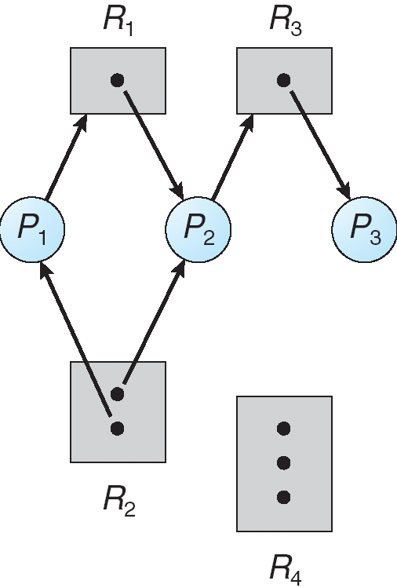
Resource-Allocation Graph

Slide 7
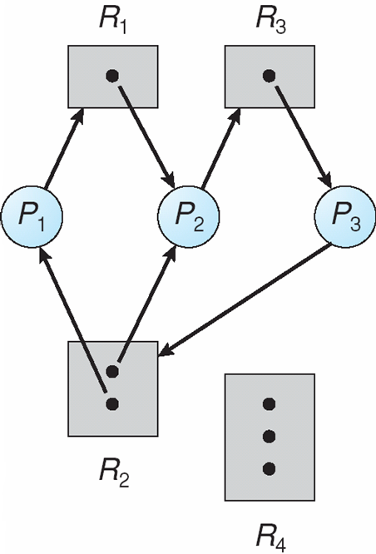
Resource Allocation Graph With A Deadlock

Slide 8
Facts About Resource Allocation Graph
If graph contains no cycles ⇒ no deadlock
If graph contains a cycle ⇒
if only one instance per resource type, then deadlock
if several instances per resource type, possibility of deadlock

Slide 9
Methods for Handling Deadlocks
Ensure that the system will never enter a deadlock state:
Deadlock prevention
Deadlock avoidance
Allow the system to enter a deadlock state, detect it and then recover
Ignore the problem and pretend that deadlocks never occur in the system; used by most operating systems, including UNIX
Notes:
Prevention, avoidance and detection is expensive and may occur infrequently (say, once per year).

Slide 10
Deadlock Prevention
Restrain the ways request can be made
Mutual Exclusion – not required for sharable resources (e.g., read-only files); must hold for non-sharable resources
Hold and Wait – must guarantee that whenever a process requests a resource, it does not hold any other resources
Require process to request and be allocated all its resources before it begins execution or allow process to request resources only when the process has none allocated to it.
Low resource utilization; starvation possible
No Preemption –
If a process that is holding some resources requests another resource that cannot be immediately allocated to it, then all resources currently being held are released
Preempted resources are added to the list of resources for which the process is waiting
Process will be restarted only when it can regain its old resources, as well as the new ones that it is requesting
Circular Wait – impose a total ordering of all resource types and require that each process requests resources in an increasing order of enumeration (BSD Unix witness can be used to verify the ordering {mutex on critical sections}). Also note that ordering does not guarantee deadlock prevention if locks can be acquired dynamically.
Notes:
Circular wait ordering depends on the application developers to write programs that follow the ordering. Which may be hard depending on the nature of the resources.

Slide 11
Deadlock Avoidance
Requires that the system has some additional a priori information available
Simplest and most useful model requires that each process declare the maximum number of resources of each type that it may need
The deadlock-avoidance algorithm dynamically examines the resource-allocation state to ensure that there can never be a circular-wait condition
Resource-allocation state is defined by the number of available and allocated resources, and the maximum demands of the processes

Slide 12
Safe State
When a process requests an available resource, system must decide if immediate allocation leaves the system in a safe state
System is in safe state if there exists a sequence <P₁, P₂, …, P_{n}> of ALL the processes in the systems such that for each P_{i}, the resources that P_{i} can still request can be satisfied by currently available resources + resources held by all the P_{j}, with j < I
That is:
If P_{i} resource needs are not immediately available, then P_{i} can wait until all P_{j} have finished
When P_{j} is finished, P_{i} can obtain needed resources, execute, return allocated resources, and terminate
When P_{i} terminates, P_{i +1} can obtain its needed resources, and so on

Slide 13
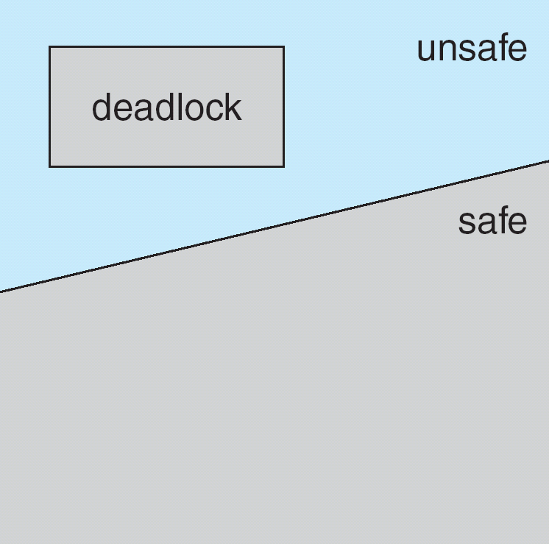
Deadlock Avoidance Facts
If a system is in safe state => no deadlocks
If a system is in unsafe state => possibility of deadlock
Avoidance => ensure that a system will never enter an unsafe state.
Notes:
Single instance of a resource type - Use a resource-allocation graph
Multiple instances of a resource type - Use the banker’s algorithm

Slide 14
Deadlock Detection
Allow system to enter deadlock state
Detection algorithm
Recovery scheme

Slide 15
Detection-Algorithm Usage
When, and how often, to invoke depends on:
How often a deadlock is likely to occur?
How many processes will need to be rolled back?
one for each disjoint cycle
If detection algorithm is invoked arbitrarily, there may be many cycles in the resource graph and so we would not be able to tell which of the many deadlocked processes “caused” the deadlock.

Slide 16
Recovery from Deadlock: Process Termination
Abort all deadlocked processes
Abort one process at a time until the deadlock cycle is eliminated
In which order should we choose to abort?
Priority of the process
How long process has computed, and how much longer to completion
Resources the process has used
Resources process needs to complete
How many processes will need to be terminated
Is process interactive or batch?

Slide 17
Recovery from Deadlock: Resource Preemption
Selecting a victim – minimize cost
Rollback – return to some safe state, restart process for that state
Starvation – same process may always be picked as victim, include number of rollback in cost factor

